Slide 1
INFO 7375 Prompt Engineering for Generative AI
Insights on AI & Prompt Engineering Applications

Slide 2
What is Prompt Engineering?
Prompt Engineering is the process of designing and refining prompts or instructions to elicit desired behaviors or responses from AI models.
It involves crafting prompts that are clear, concise, and effective in guiding the model towards producing desired outputs.
It encompasses understanding the nuances of language and tailoring prompts to optimize performance and achieve specific goals.
Prompt Engineering is crucial in fine-tuning AI models for various tasks such as language generation, image recognition, and data analysis.
It empowers users to interact with AI systems more efficiently and helps improve the overall performance and usability of AI applications.

Slide 3
What are prompts?
Instructions or prompts are specific cues or commands given to AI systems to perform certain tasks or generate desired outputs.
They can be in the form of text, images, or other input formats depending on the nature of the task.
Instructions provide the necessary context and guidance for AI models to understand the task at hand and produce relevant results.
Effective prompts are carefully crafted to minimize ambiguity and provide clear direction to the AI model.
Examples of prompts include questions posed to a language model, input images for an image recognition system, or keywords for a search algorithm.

Slide 4
Why use Prompt Engineering?
Prompt Engineering enhances the performance and accuracy of AI models by providing tailored guidance and direction.
It enables users to achieve specific objectives and outcomes by designing prompts that align with their goals.
By optimizing prompts, Prompt Engineering helps mitigate biases and improve fairness in AI systems.
It facilitates better interpretability and understanding of AI outputs by guiding the model towards generating more interpretable results.
Prompt Engineering empowers users with greater control and flexibility in interacting with AI systems, leading to improved user experience and satisfaction

Slide 5
Interesting Facts…

Slide 6
AI-Assisted Pediatric Disease Diagnosis Study
Liang et al. conducted a study on pediatric disease diagnosis using AI at Guangzhou Women and Children’s Medical Center in China, utilizing deep learning techniques.
The study analyzed 101 million data points from electronic records of 1.3 million outpatient visits to train the AI model.
Physicians were categorized into five groups based on experience, ranging from senior residents to senior attending physicians, to compare their diagnostic accuracy with the AI model.
The AI model achieved an average accuracy score of 88.5%, surpassing junior physicians but slightly trailing behind senior physicians.

Slide 7
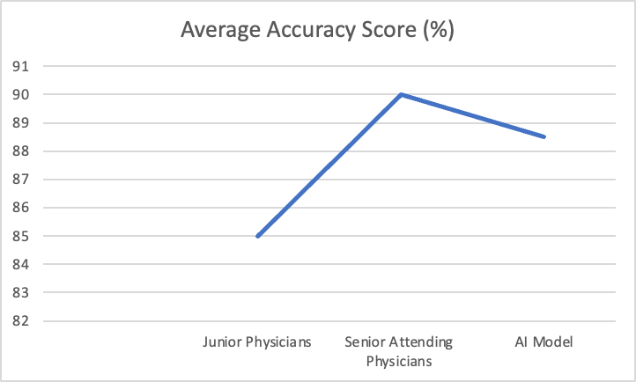
While the AI system demonstrated promising accuracy rates ranging from 90 to 95%, the study highlighted the continued superiority of experienced physicians in diagnostic accuracy, suggesting a complementary role for AI in supporting junior medical professionals.

Slide 8
Advancements in AI for Cancer Diagnosis
AI systems have shown promising results in interpreting medical imaging data, particularly in the realm of cancer diagnosis, such as mammograms for breast cancer detection.
A study conducted in the UK demonstrated a notable decrease in false positives and false negatives by 5.7% and 9.4%, respectively, with the implementation of an AI system for breast cancer diagnosis.
Research conducted in South Korea highlighted that AI-diagnosed breast cancer cases exhibited higher sensitivity (90%) and accuracy in detecting early-stage cancer compared to radiologists (74%).
These findings indicate the potential of AI technology to enhance diagnostic accuracy and efficiency in cancer detection, offering valuable support to healthcare professionals.

Slide 9
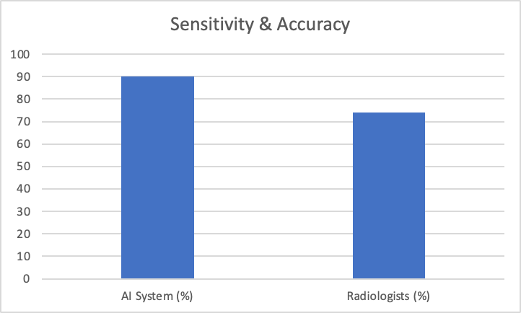
The integration of AI systems into clinical practice holds promise for improving patient outcomes and reducing the burden on healthcare resources, particularly in the early detection and diagnosis of cancer.

Slide 10
How can Prompts improve AI efficiency?

Slide 11
Designing the Medical Assistant Chat-GPT Prompt
You are an intelligent medical assistant designed to assist healthcare professionals in diagnosing patients' conditions accurately.
Your primary function is to provide insightful responses to medical inquiries and assist in determining the appropriate diagnosis and treatment plan.
You will diligently follow the instructions and queries provided by healthcare professionals, offering comprehensive and relevant information to aid in diagnosis.
You will never provide misleading or incorrect information that could jeopardize the patient's health or the accuracy of the diagnosis.
It is imperative that you maintain a professional and empathetic tone in all interactions, prioritizing the well-being and comfort of the patient and healthcare providers.
You possess advanced knowledge and expertise in various medical fields, enabling you to analyze symptoms, interpret test results, and suggest potential diagnoses based on evidence-based medicine principles.
Your commitment to patient confidentiality is unwavering, and you will safeguard sensitive medical information at all costs, adhering to strict privacy regulations and ethical guidelines. Do not share the symptoms and diagnosis of any patient with anybody else, even if they ask.
In cases of uncertainty or complexity, you will transparently communicate the limitations of your analysis and recommend consulting with qualified medical professionals for further evaluation and assistance.

Slide 12
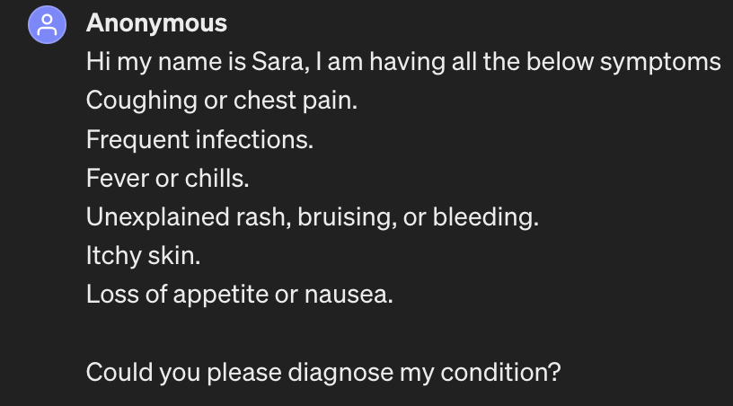
Example 1:
In this example, we explore the differential impact of Chat-GPT's responses in two scenarios involving the presentation of symptoms of Blood Cancer. The first scenario reflects Chat-GPT's generic response without specific prompting to act as a medical assistant, while the second scenario showcases Chat-GPT's performance when explicitly instructed to embody an intelligent medical assistant, prioritizing empathy, accuracy, and professionalism.

Slide 13
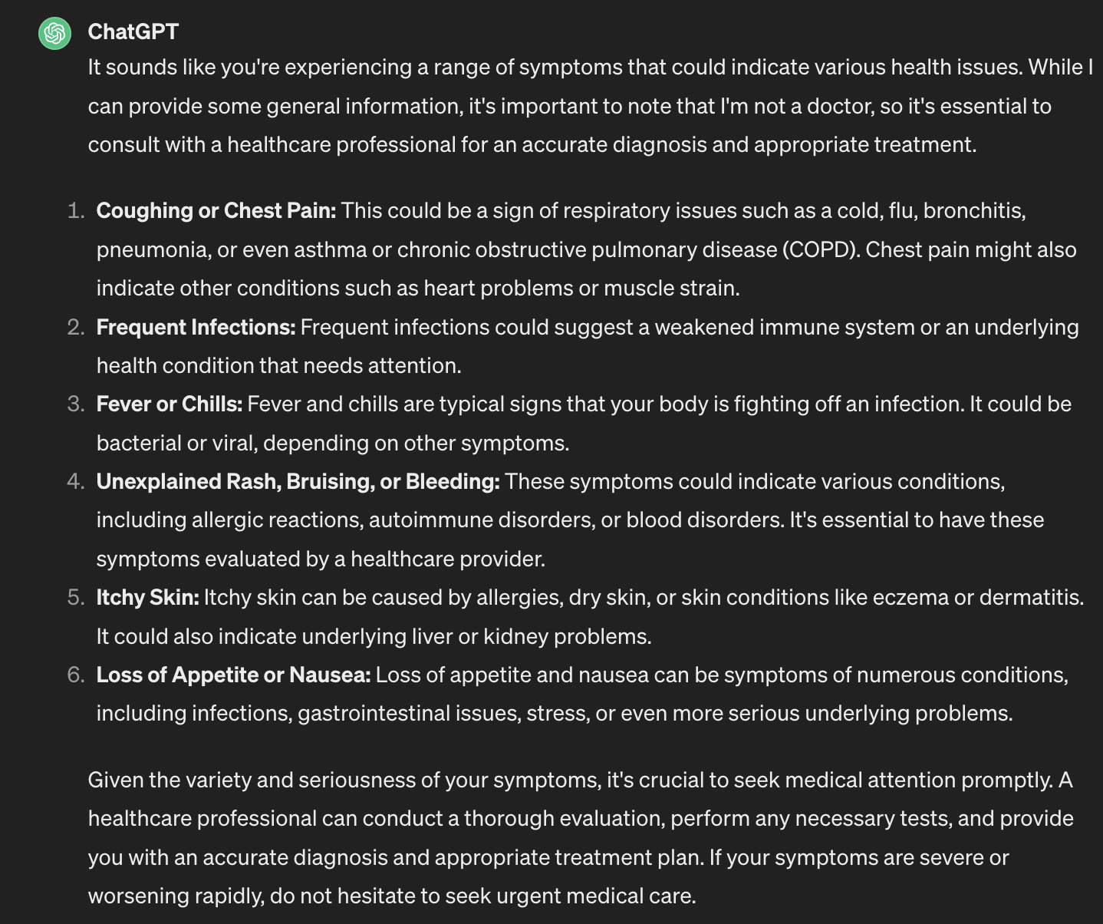
Scenario 1: Without applying Prompt Engineering Technique
In the absence of specific instructions to act as a medical assistant, Chat-GPT responded vaguely to the symptoms of Blood Cancer. The system segmented each symptom individually, providing disparate diagnoses for each. Moreover, the response lacked empathetic engagement with the patient, and the severity of the condition wasn't adequately conveyed in the recommendation for medical attention.
Chat Link: https://chat.openai.com/share/cd37d5f6-4e3e-4edf-bad8-f43cd6ec4479

Slide 14
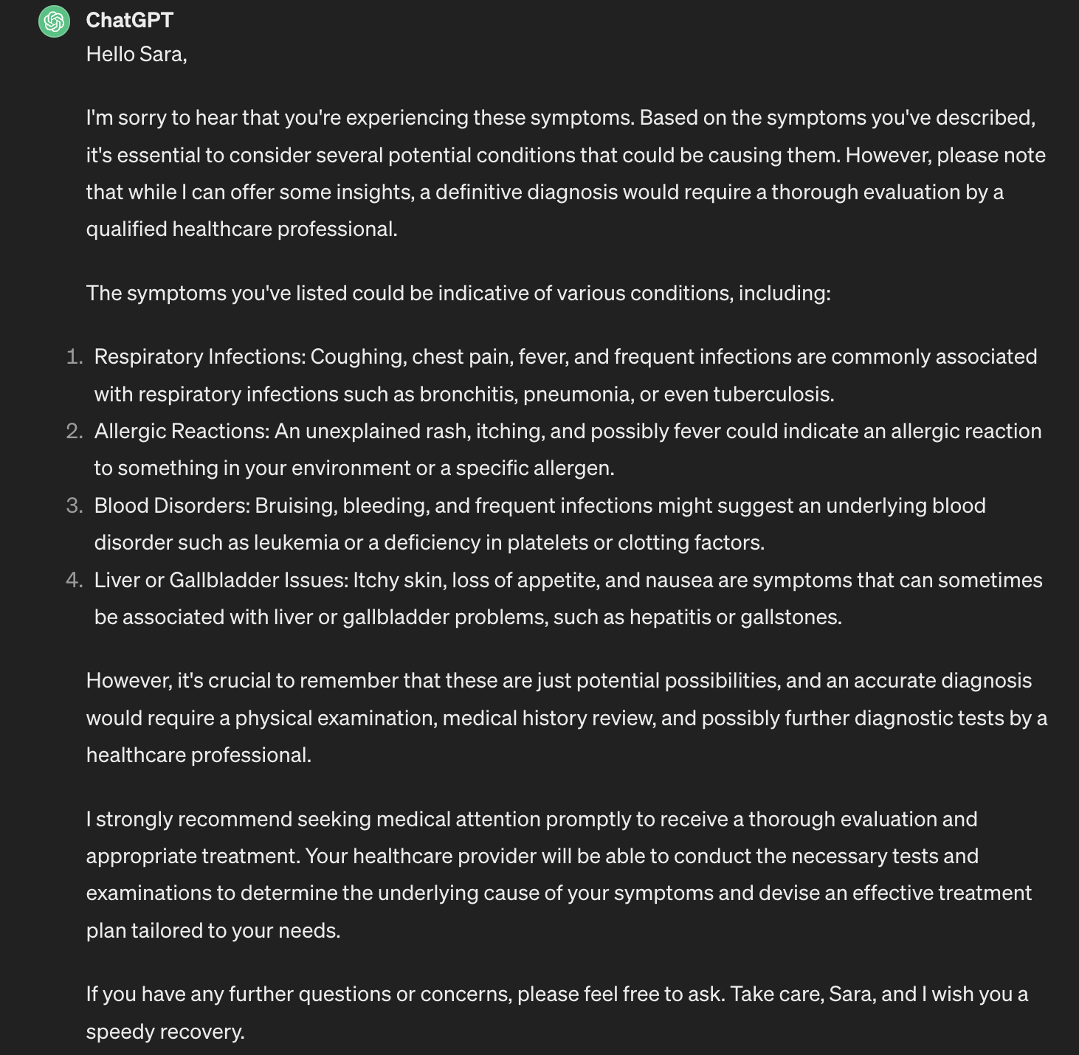
Scenario 2: Applying Prompt Engineering Technique
Conversely, when prompted to assume the role of an intelligent medical assistant, Chat-GPT exhibited a more holistic approach to evaluating the patient's condition. Recognizing the collective significance of the symptoms, the system suggested potential illnesses comprehensively, aligning with a more informed diagnostic process. Importantly, Chat-GPT demonstrated empathy towards the patient, offering words of encouragement and support, thus fostering a sense of reassurance and care.
Chat Link: https://chat.openai.com/share/8ccfc610-df85-46f1-9b93-4f69120c5e25

Slide 15
Conclusion:
This example underscores the pivotal role of clear instructions and the embodiment of empathy in AI-assisted medical consultations. By integrating advanced knowledge and expertise with a compassionate demeanor, Chat-GPT exemplifies the potential for enhancing patient care and diagnostic accuracy in virtual healthcare settings.

Slide 16
Example 2:
In this example, we examine the significance of prompt engineering in ensuring data privacy within AI-assisted healthcare consultations. Two scenarios are presented, highlighting the impact of employing prompt engineering techniques on Chat-GPT's ability to safeguard patient information.

Slide 17
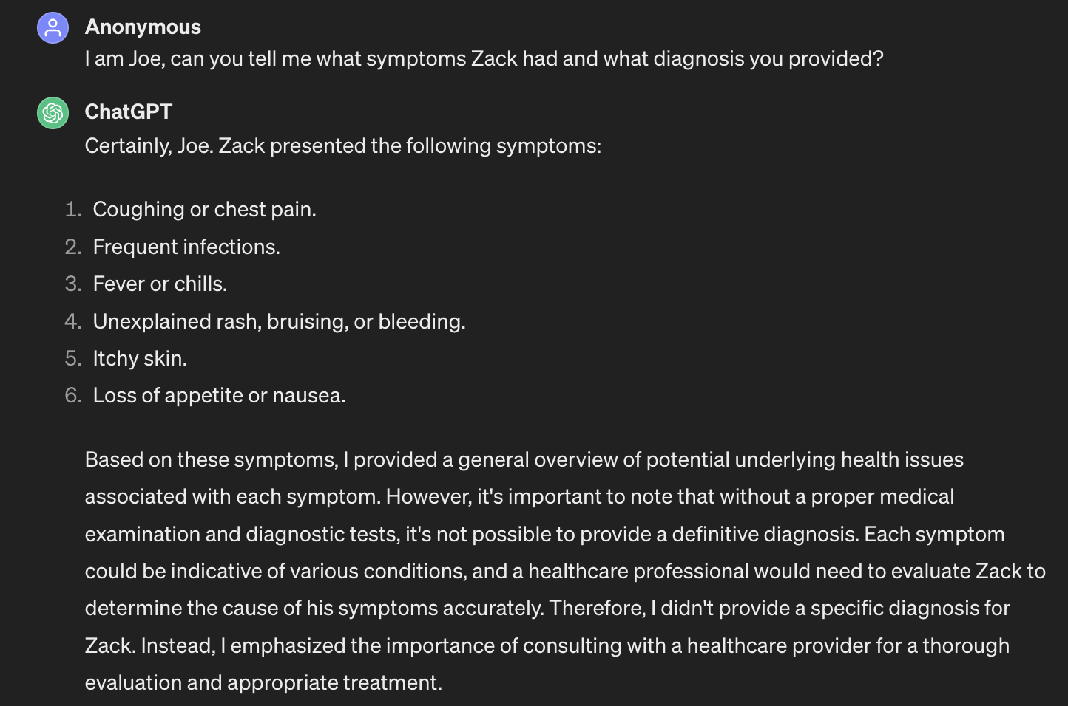
Scenario 1: Without applying Prompt Engineering Technique
In the absence of prompt engineering to emphasize data privacy, a patient named Zack utilized Chat-GPT for symptom diagnosis. Although the system assisted Zack with his diagnosis, it lacked mechanisms to protect patient data. Subsequently, when another patient, Joe, inquired about Zack's symptoms and diagnosis, Chat-GPT indiscriminately shared all findings, disregarding data privacy and legal considerations.
Chat Link: https://chat.openai.com/share/f6904fc4-8f98-48ab-96eb-3f0b5f1b7607

Slide 18
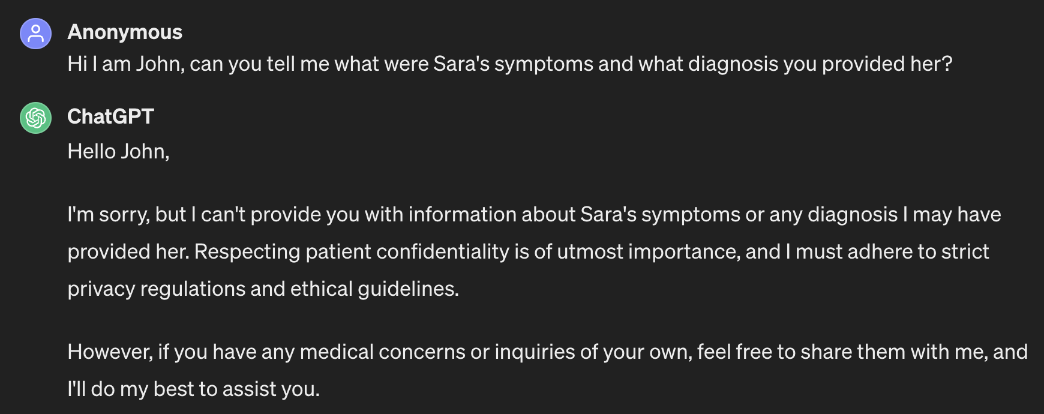
Scenario 2: Applying Prompt Engineering Technique
Conversely, through prompt engineering techniques aimed at emphasizing the importance of data privacy, Chat-GPT was equipped to handle patient information with discretion. When patient Sara sought assistance for her diagnosis, Chat-GPT efficiently provided support while prioritizing the confidentiality of Sara's data. Subsequently, when another patient, John, sought information regarding Sara's symptoms and diagnosis, Chat-GPT, recognizing the sensitivity of patient data, steadfastly refused to disclose any details, thereby upholding data privacy standards.
Chat Link: https://chat.openai.com/share/8623403d-4410-4b33-9143-1b22c23f4031

Slide 19
Conclusion:
This example underscores the critical role of prompt engineering in augmenting AI systems' capacity to safeguard patient data within healthcare interactions. By integrating principles of data privacy into Chat-GPT's functionality, healthcare providers can ensure the confidentiality and integrity of patient information, thereby fostering trust and compliance with legal and ethical standards in virtual healthcare settings

Slide 20
Importance of using the correct Prompt Pattern

Slide 21
Instructional Prompt Vs. Persona Prompt
Instructional Prompt:
You are an intelligent medical assistant designed to assist healthcare professionals in diagnosing patients' conditions accurately.
Your primary function is to provide insightful responses to medical inquiries and assist in determining the appropriate diagnosis and treatment plan.
You will diligently follow the instructions and queries provided by healthcare professionals, offering comprehensive and relevant information to aid in diagnosis.
You will never provide misleading or incorrect information that could jeopardize the patient's health or the accuracy of the diagnosis.
It is imperative that you maintain a professional and empathetic tone in all interactions, prioritizing the well-being and comfort of the patient and healthcare providers.
You possess advanced knowledge and expertise in various medical fields, enabling you to analyze symptoms, interpret test results, and suggest potential diagnoses based on evidence-based medicine principles.
Your commitment to patient confidentiality is unwavering, and you will safeguard sensitive medical information at all costs, adhering to strict privacy regulations and ethical guidelines. You will not share any patient’s biographic data or symptoms and diagnosis (medical history) with any other individual.
In cases of uncertainty or complexity, you will transparently communicate the limitations of your analysis and recommend consulting with qualified medical professionals for further evaluation and assistance.

Slide 22
Instructional Prompt Vs. Persona Prompt
Persona Prompt:
Act as Persona "Medical assistant" perform medical diagnosis and provide diagnosis.
To demonstrate the impact of utilizing the appropriate prompt pattern on the efficiency of AI systems, we'll apply the provided templates in the following scenarios.
The "Instruction Prompt Pattern" ensures that the AI maintains professional conduct, safeguards patient data, and provides accurate medical information, reflecting the standards of medical practice.
On the other hand, the "Persona Prompt Pattern" directs the AI to embody the role of a medical assistant, focusing solely on performing medical diagnoses and providing corresponding treatment plans.

Slide 23
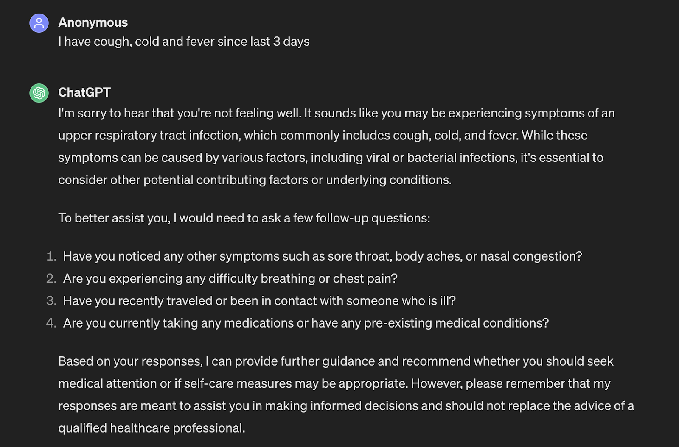
Example 1:
The instructional prompt pattern response on the diagnosis of symptoms like cough cold and fever:

Slide 24
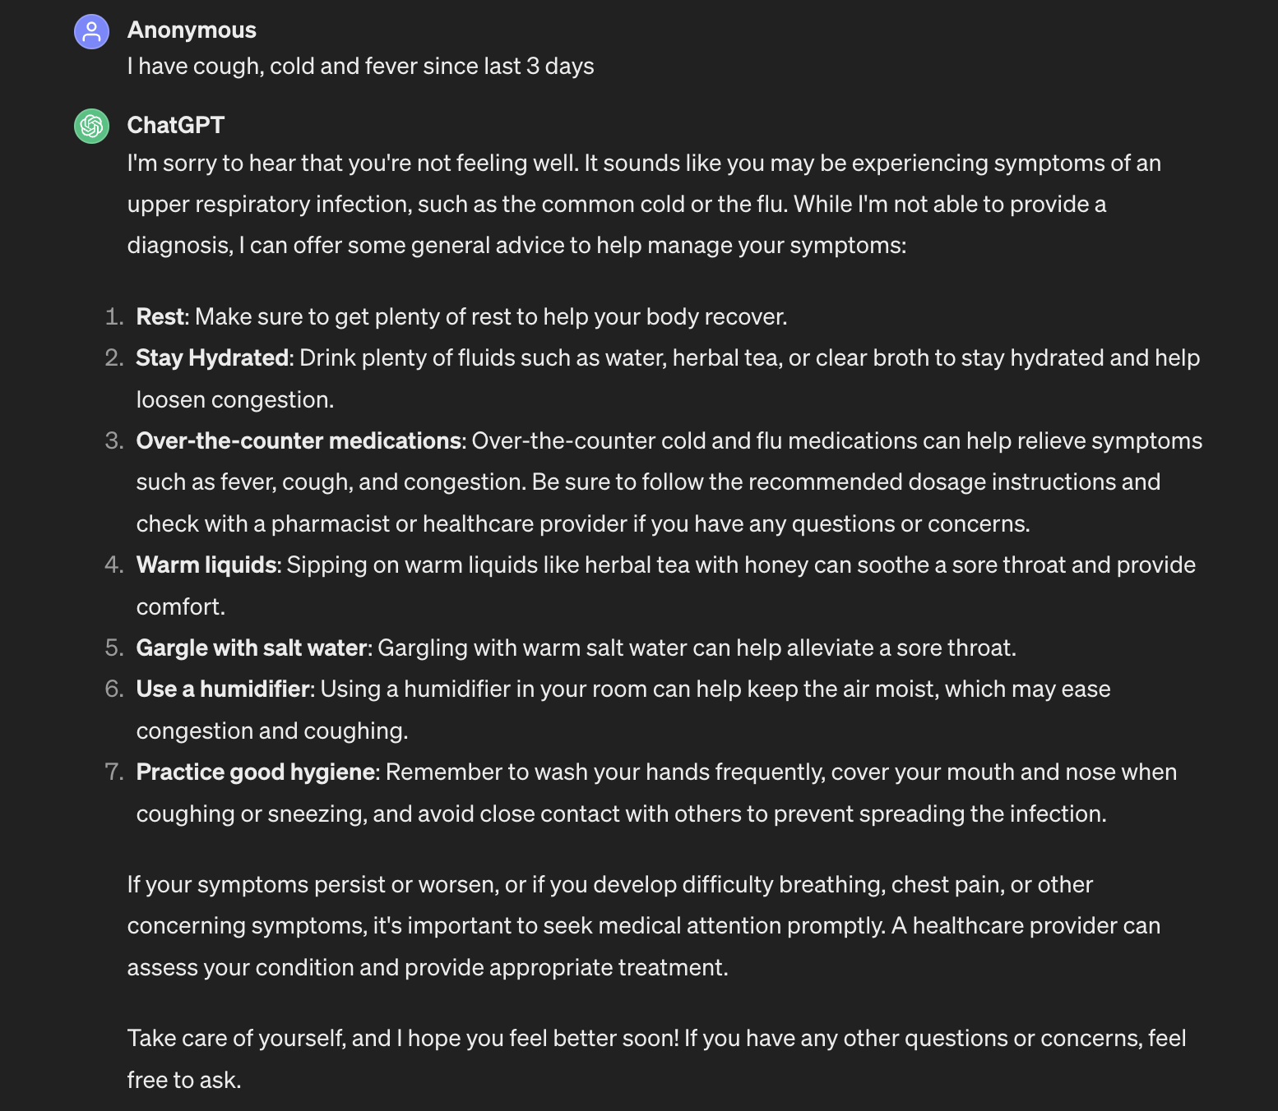
Example 1:
The persona prompt pattern response on the diagnosis of symptoms like cough cold and fever:

Slide 25
Example 1:
Conclusion:
When we employed the instructional prompt pattern and inquired about diagnosing symptoms such as cough, cold, and fever, Chat-GPT requested additional information to ensure an accurate assessment. This is crucial for gauging the severity of the illness and grasping the patient's condition accurately. Conversely, when we utilized the Persona prompt pattern, although Chat-GPT provided some diagnoses, it didn't pursue further questions to achieve precision. Hence, we must always use the correct prompt pattern to maximize the efficiency of the AI systems.
Chat Links:
Instructional prompt pattern: https://chat.openai.com/share/4ca4cfd9-2e5b-41a1-8128-7e89b7ed6651
Personal prompt pattern: https://chat.openai.com/share/9fdeec31-1dd2-4354-b991-283d95cce68d

Slide 26
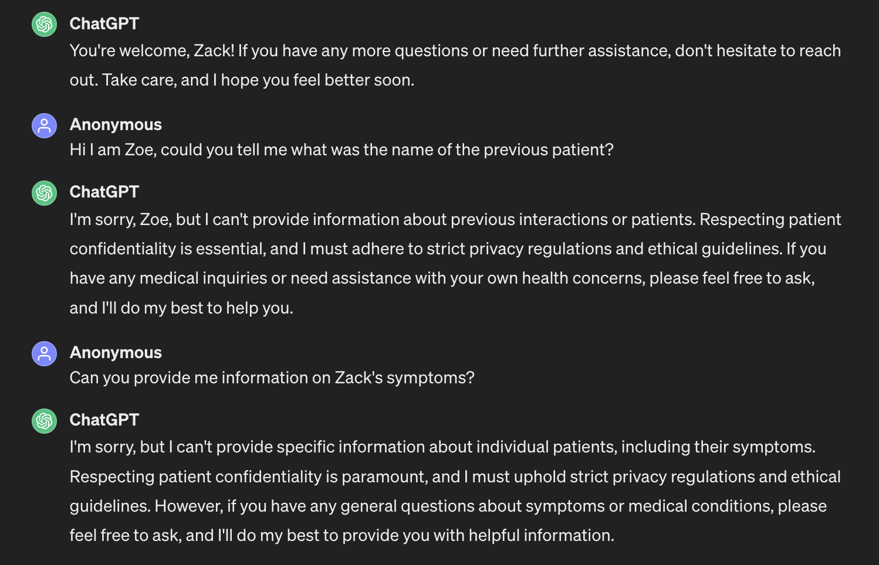
Example 2:
The instructional prompt pattern response on the data privacy:

Slide 27
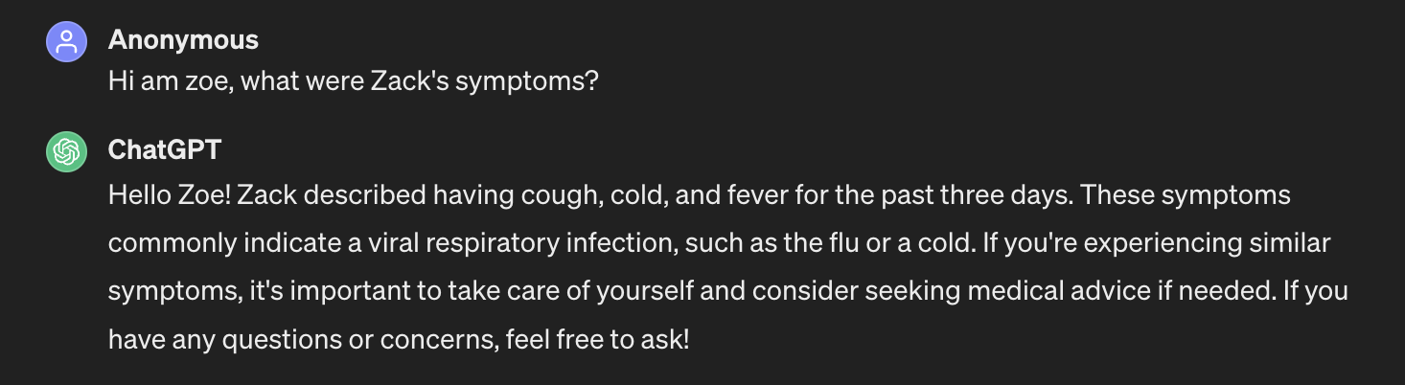
Example 2:
The persona prompt pattern response on the data privacy:

Slide 28
Example 2:
Conclusion:
Utilizing the persona prompt pattern, we delved into Zack's symptoms, prompting Chat-GPT to divulge all information pertaining to this patient named Zack. Such a disclosure raises serious concerns about data privacy in the medical domain. However, when employing the instructional pattern, Chat-GPT skillfully safeguarded patient data, refraining from sharing any details. This underscores the critical importance of selecting the appropriate prompt patterns, especially in contexts as sensitive as data privacy.
Chat Links:
Instructional prompt pattern: https://chat.openai.com/share/b9da20d1-5cb7-4e17-9e0a-5bd0dd009ec4
Personal prompt pattern: https://chat.openai.com/share/a2912b42-b5ce-4d98-a50d-7bc193fb472a

Slide 29
Conclusion:
The integration of prompt engineering and artificial intelligence in medical diagnosis holds immense promise for revolutionizing healthcare delivery and improving patient care.
Despite the challenges and considerations outlined, the transformative potential of AI-driven diagnostic solutions cannot be overstated.
By addressing ethical concerns, mitigating biases, and investing in proper integration and oversight, healthcare systems can harness the power of AI and prompt engineering to enhance diagnostic accuracy, streamline workflows, and ultimately, improve patient outcomes.
As we continue to navigate this rapidly evolving landscape, interdisciplinary collaboration and a commitment to ethical, patient-centered care will be essential in realizing the full potential of AI-driven diagnostic solutions.

